Slide 1
FROM GLOBAL WARMING TO climate change
Notes:
I am Doctor Stanley Dienst, a long-time member of “Physicians for Social Responsibility.” Our group is known for advocating the universal abolition of nuclear weapons. Its members are both medical professionals and other concerned citizens. It is now also using its voice and resources to address the impending threat of global Warming. My son Brad Dienst is a Co-Author and technical advisor (First Slide)
This presentation will update our current understanding of global warming and one of its many threatening climate changes, i.e. drought in the Western United States.

Slide 2
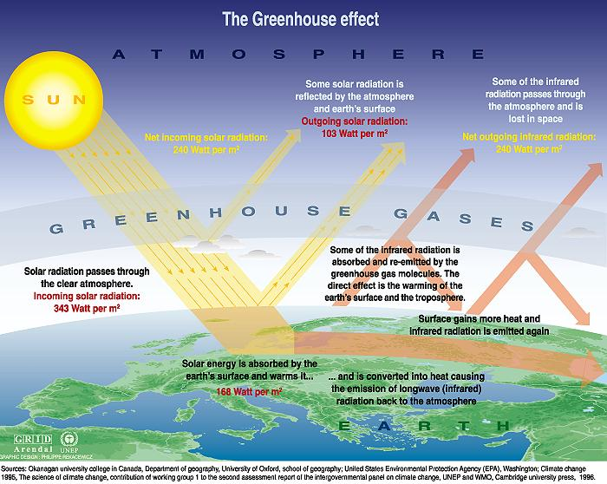
Notes:
Normally half of solar radiation that is absorbed by the surface of the earth returns to space through the atmosphere as infrared radiation Greenhouse gases (namely C02 and Methane), when in the atmosphere, absorb a portion of the exiting infrared radiation and reflect it back to the earth. There it releases its energy as heat altering the fine balance of radiation from the sun with that going back to space, thus warming the earth.

Slide 3
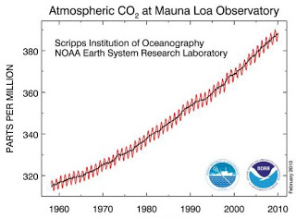
Notes:
In 1956, it was David Keeling working at the Scripps Institute in California who first began to monitor the concentration of C02 in the atmosphere and correlate its rise with increasing temperature. From the 1970s his data have been verified by the National Oceanic and Atmospheric Administration. Over fifty years ago, Keeling was predicting and warning of the climate changes that would ensue if C02 concentrations were not controlled.

Slide 4
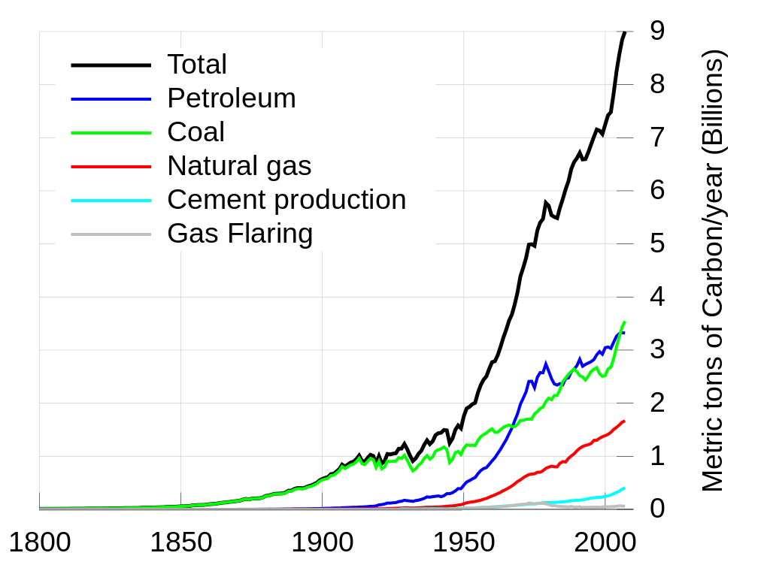
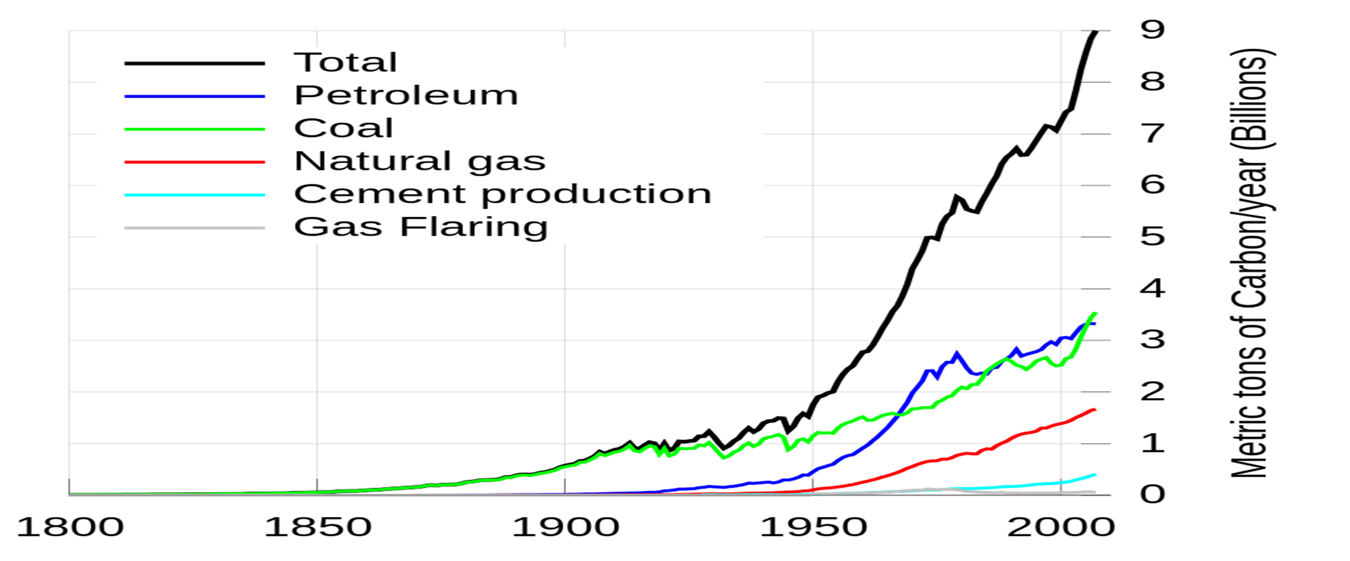
Notes:
The black line on this graphic shows the total increase in carbon in the world’s atmosphere over the last two centuries. The colored lines indicate the sources
Which are fossil fuels Petroleum, coal and natural gas.

Slide 5
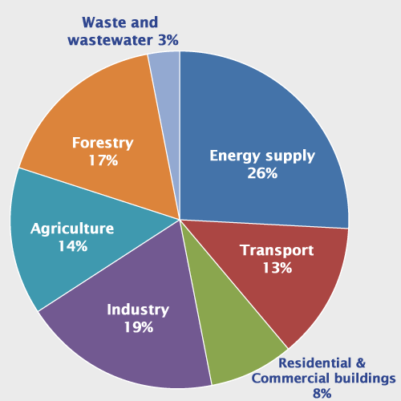
Notes:
This pie chart shows the relative disdribution to CO2 production by different human activities. You’ll note that energy production and transport make up 39% of the total. This CO2 production can be lowered substantially by individual conservation.

Slide 6
HOW An altered Polar jet stream
Delivers our extreme weather
Notes:
The polar jet stream is a broad band of wind blowing swiftly from west to east, four to eight miles above the surface of the earth . It circles the earth. There are variations in its course, in response to Arctic temperature changes. These variations produce our normal weather patterns in the more southern latitudes of the hemisphere.

Slide 7
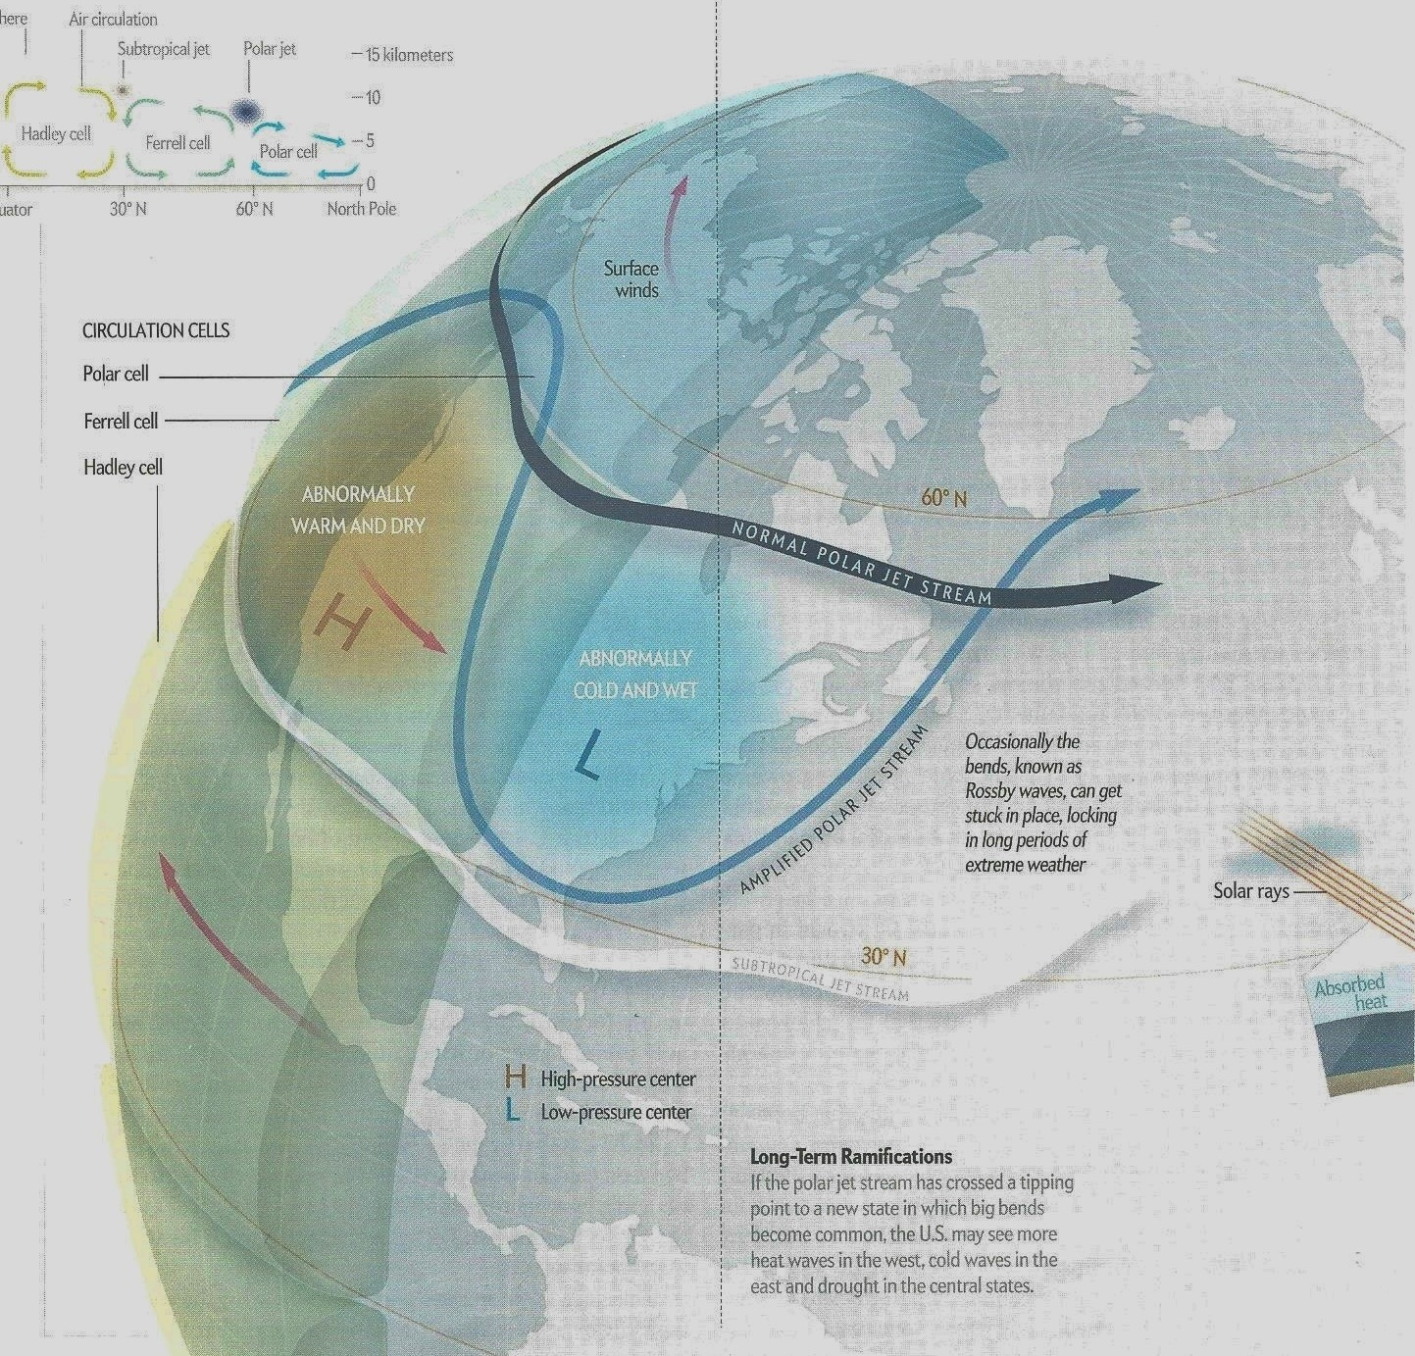
Notes:
Now, rapid ice-melt from global warming in the Arctic is exposing increasingly large areas of dark heat absorbing open water. The resulting rising temperature produces marked changes in the polar Jet stream pattern termed “Rossby waves. This particular wave is thought to have produced warm dry weather and drought over one side of the continent and extremely wet and cold weather on the other side.

Slide 8
… The consequences :
water shortages
in
southwestern states
Notes:
Lack of rainfall and minimum flow in rivers is increasingly disrupting agriculture and ranching in the Southwest. The above ground reservoirs of major cities are depleted. Pumping adequate ground water from vanishing deep aquifers is a temporizing “solution.” Forty million people in five states are threatened with an unresolved water shortage.

Slide 9
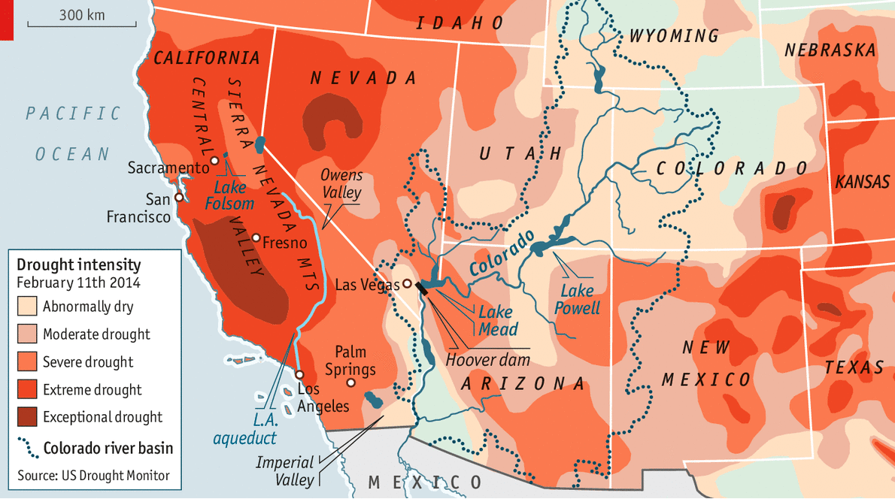
Notes:
These problems are most acute in California which has been dependent on the now diminishing annual snow pack from the Sierra Nevada Mountains and from the Colorado River.
In the past the river has carried abundant water from the snow pack in the western high Colorado Rockies to Lake Powell and Lake Mead. With markedly diminished snowfall in the mountains, Water levels in Lake Mead are down more than seventy feet (a crisis level). Flow through the dam to the river below to California, Nevada and Arizona is necessarily very restricted.

Slide 10
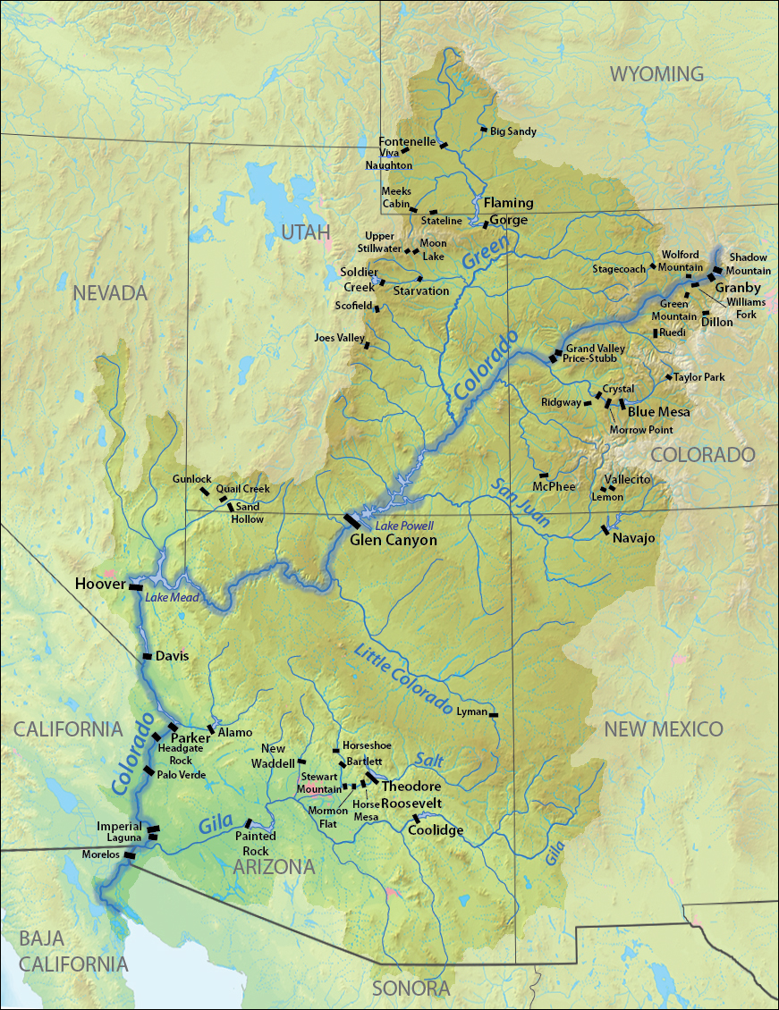
Notes:
This map shows the coarse of the Colorado river and the States most affected by Drought, California, Nevada and Arizona.

Slide 11
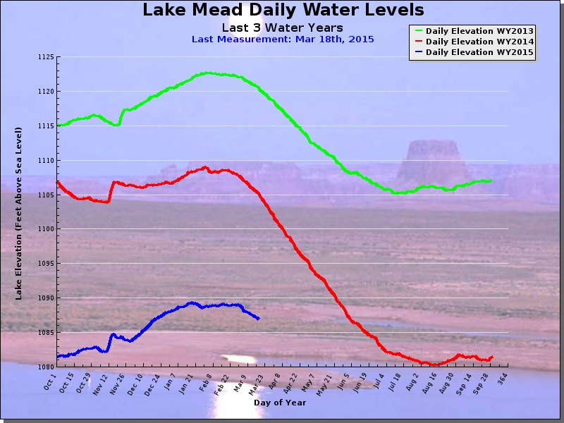
Notes:
This graph shows what happened to the water level of Lake Mead in the years 2013 (Yellow), 2014 (red) and up to march of this year (blue line). Most of the fall in the level happened in 2014, reaching a crisis level in August. At that time, water was released from Lake Powell upstream above Boulder Dam to bring the level up eight feet.

Slide 12
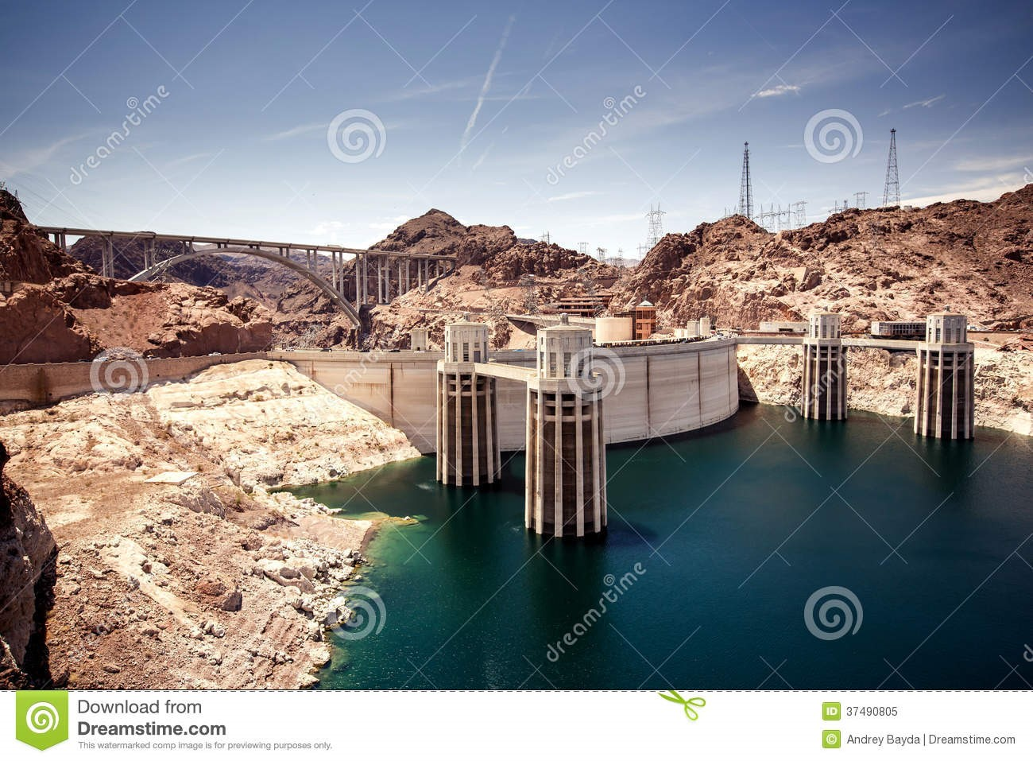
Notes:
This is the Hoover Dam from above forming the now depleted Lake Mead and the exposed water intake towers.

Slide 13
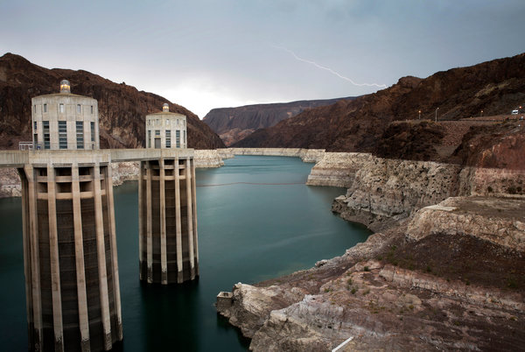
Notes:
This is the view looking up stream through the “Narrows. The white discoloration of the shoreline are mineral deposits on the rock from the lake when it was full.

Slide 14
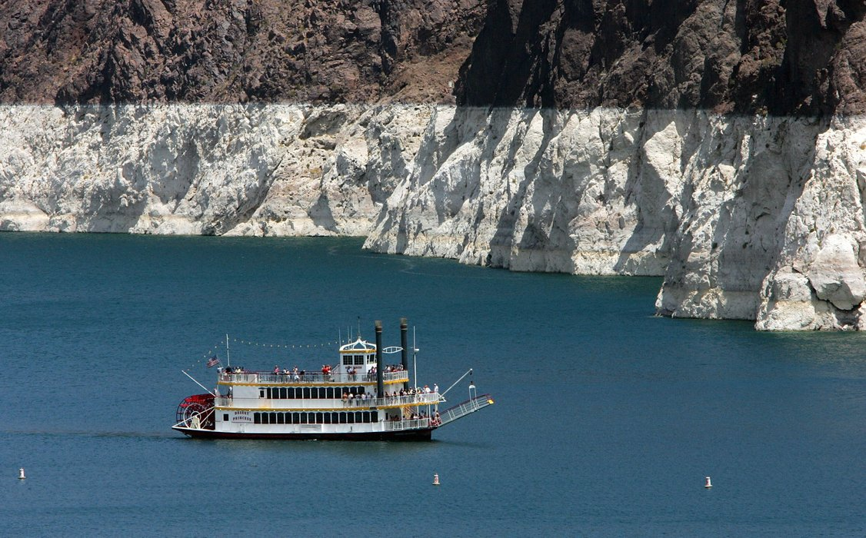
Notes:
The lake continues as a popular recreation and fishing site though many marinas have closed.

Slide 15
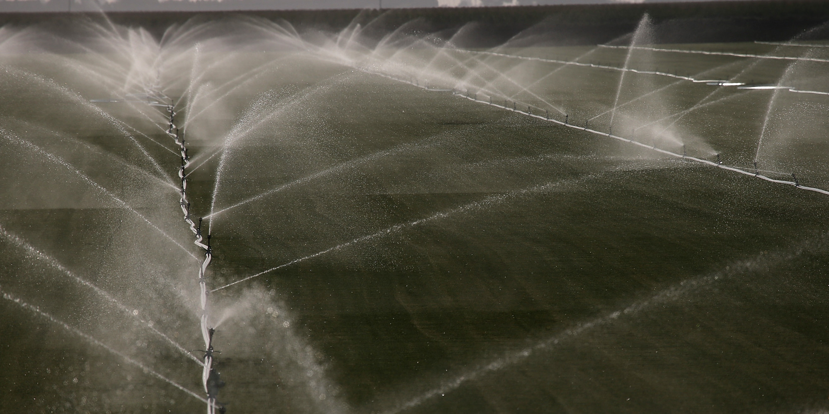
Notes:
Watering of fruits and vegetables in the Central Valley of California has been the main use of water until recently. Now it has been curtailed with loses of over two billion dollars

Slide 16
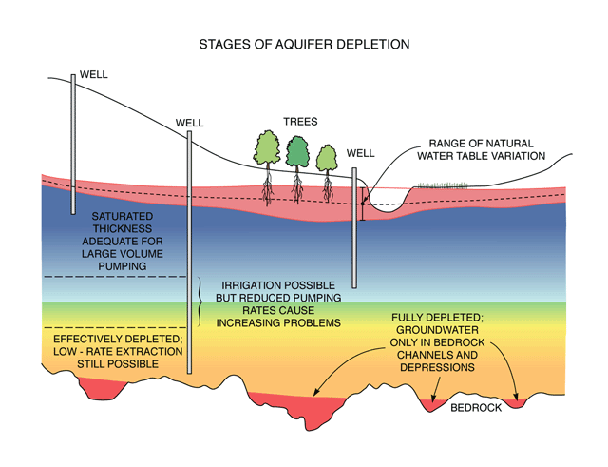
Notes:
Farmers in the Central valley have become dependent on drilling for ground water. The diagram illustrates the problems and uncertainty of this effort

Slide 17
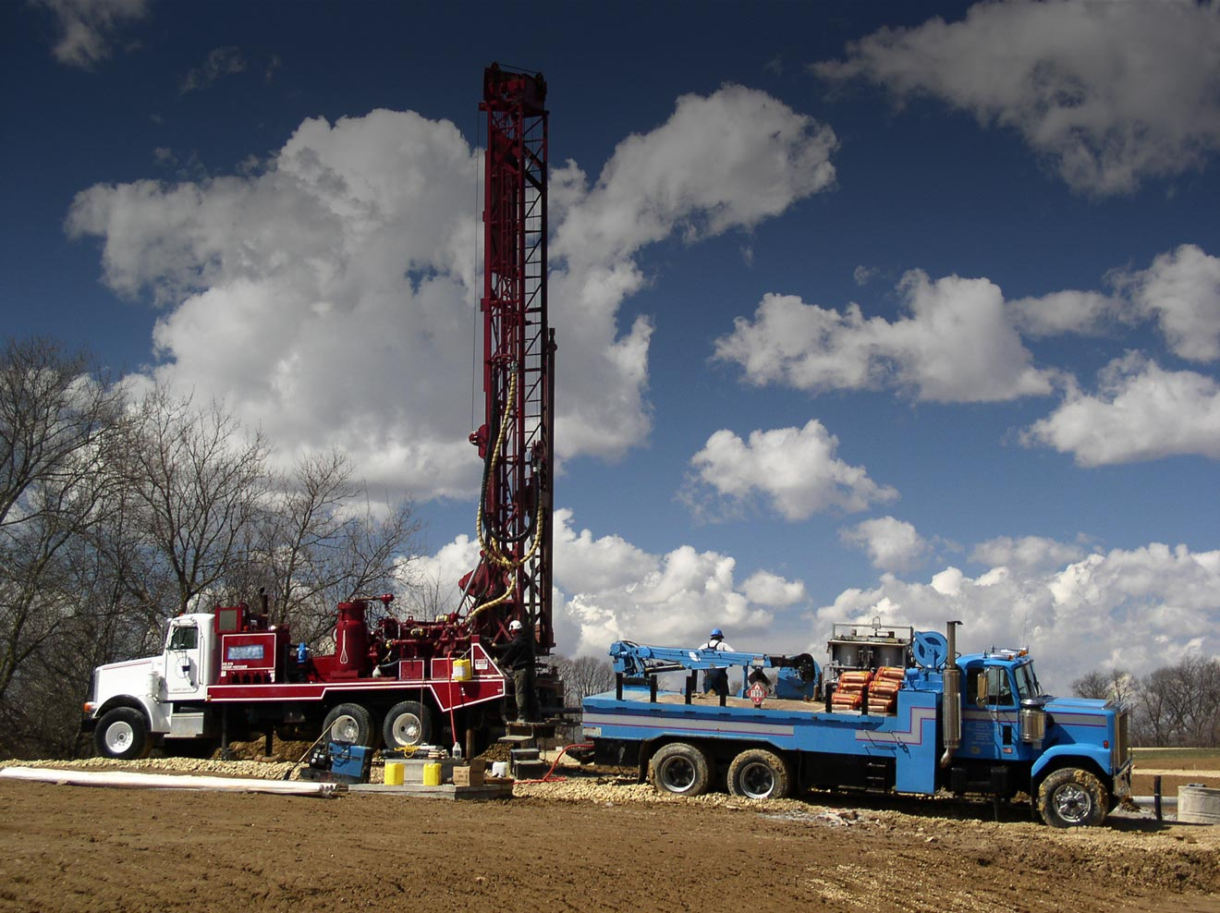
Notes:
, Over three hundred million dollars each year are spent searching for accessible water for irrigation. This is equivalent to all the cost of planting and harvesting

Slide 18
Global warming and climate change
Making our earth Unliveable
Making mankind unforgiveable
What must we do ?
We must Stop making c02 !
Notes:
The PROBLEM and THE SOLUTION

Slide 19
By International commitment
Stop using fossil fuels (and Tax Carbon)
Generate electric power by solar, wind and Hydro
Control Military expenditures and influence
Get Everyone informed, conserving and politically active

