Slide 1
Physicians for Social Responsibility of Western North Carolina
2021
www.wncpsr.org

Slide 2
The Cherry Tree Project
In Downtown Asheville North Carolina—sponsored by WNC PSR in commemoration of the 75th Anniversaries of Hiroshima and Nagasaki

Slide 3
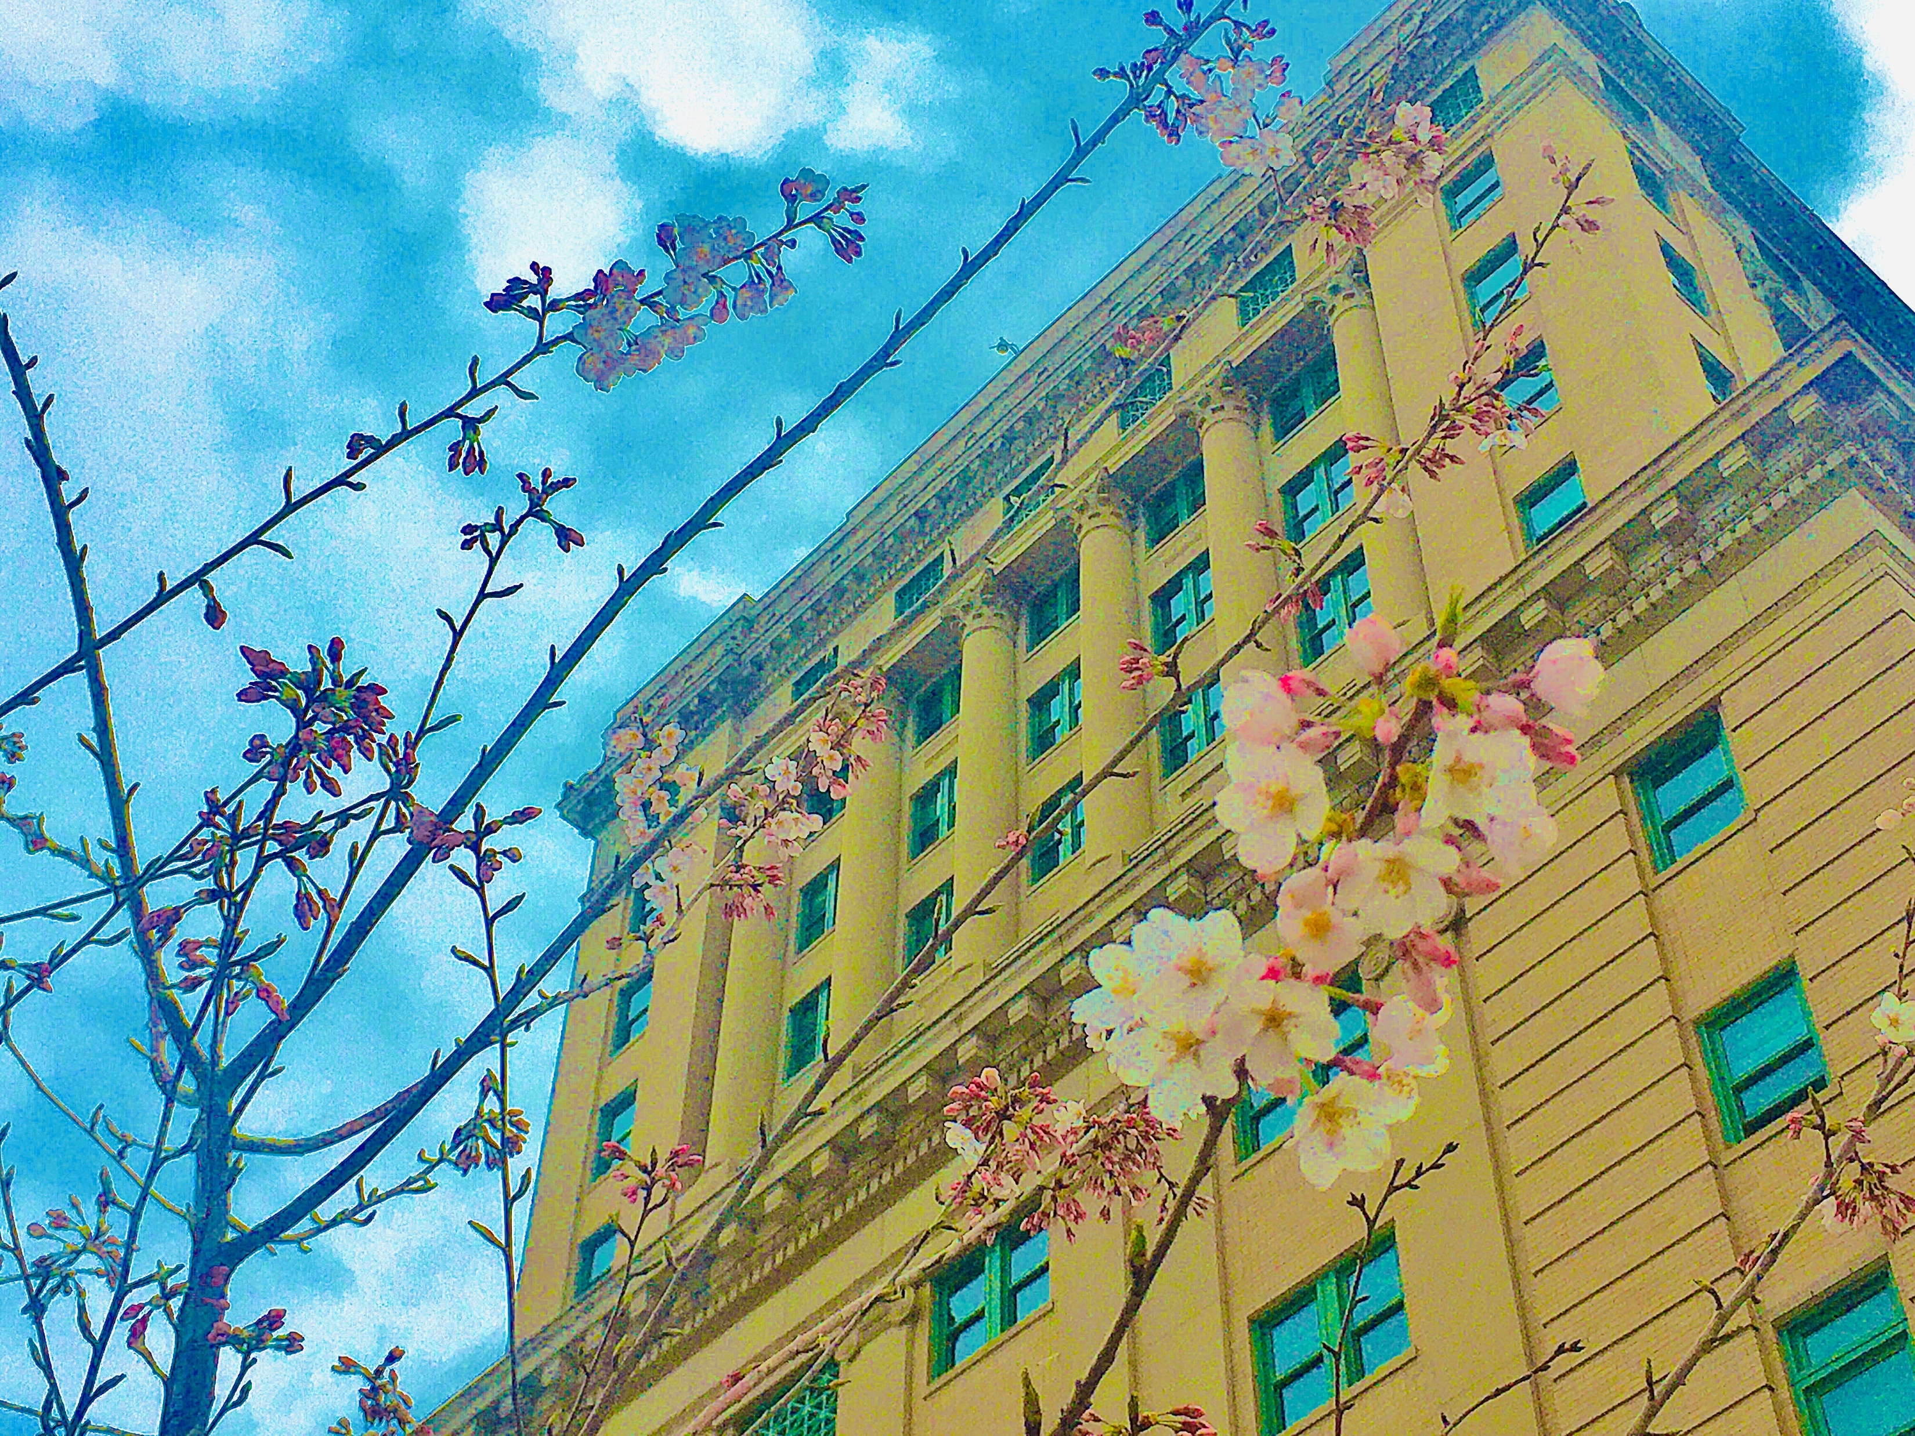

Slide 4
Leslie Poplawski was the originator and organizer of the Cherry Tree Project

Slide 5
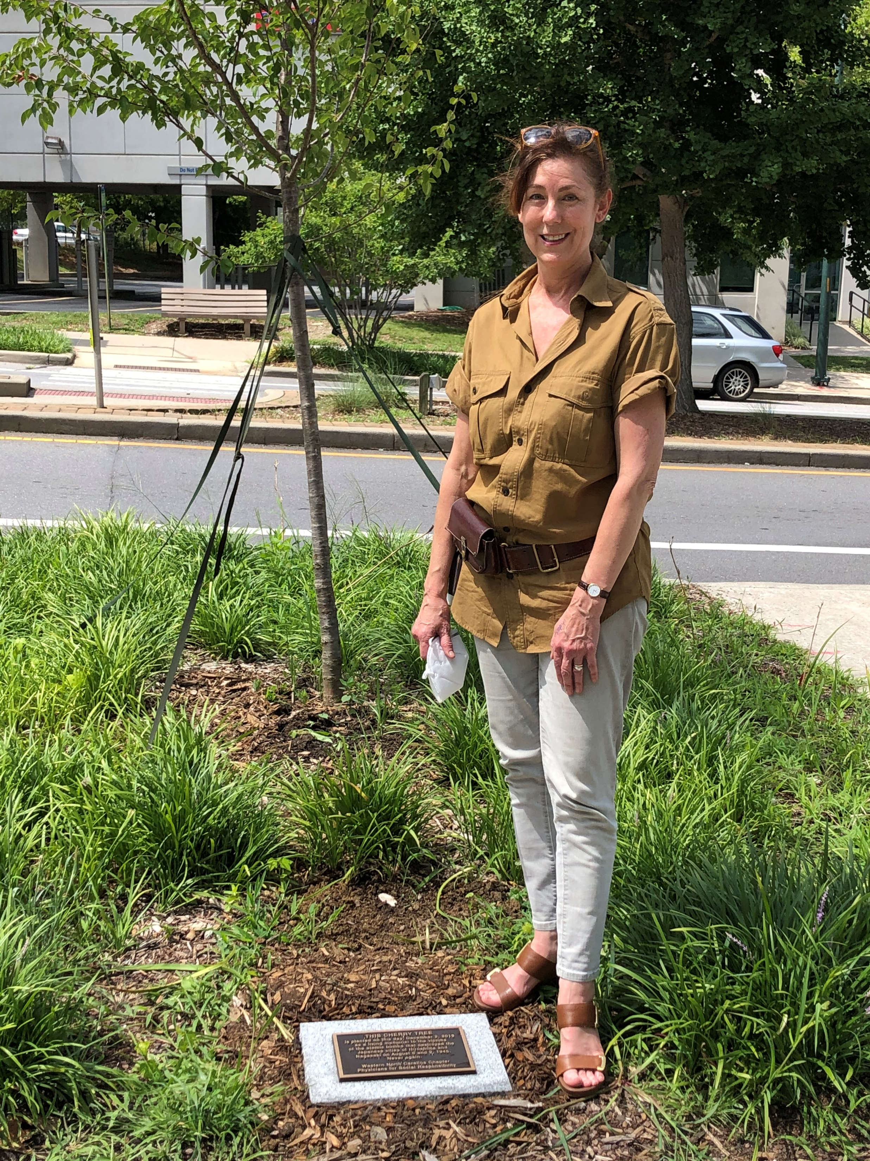

Slide 6
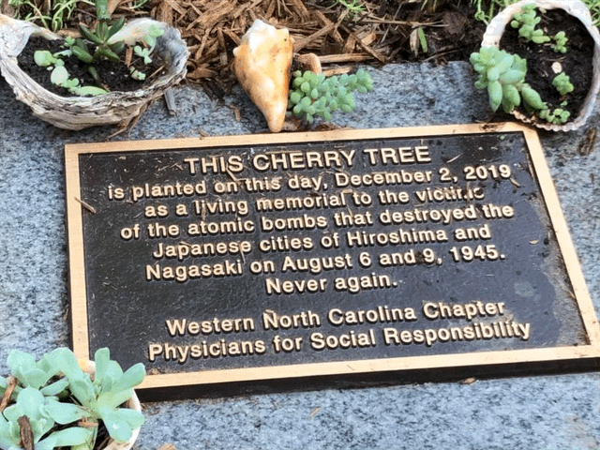

Slide 7
Leslie, Brita and Terry maintain the commemorative tree and garden site which is near our county and city courthouses.

Slide 8
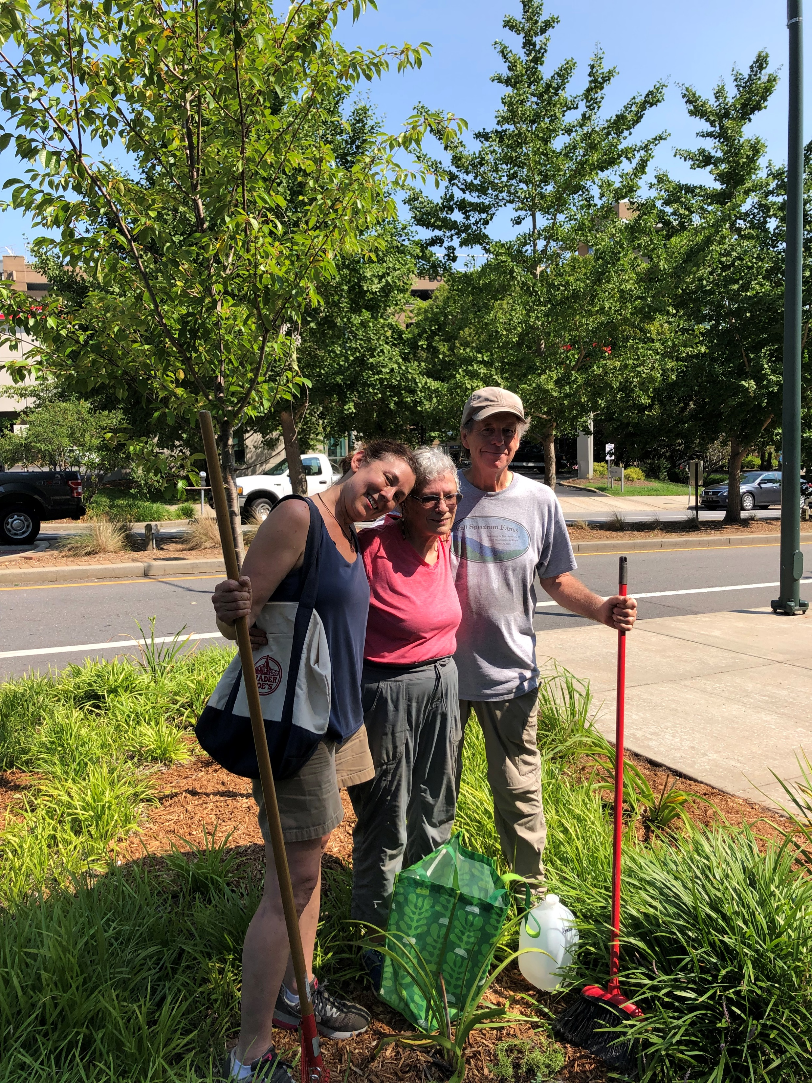

Slide 9
WNC PSR often meets at the home of Terry Clark and Brita Larsen Clark—Brita is behind the amazing zucchini!

Slide 10
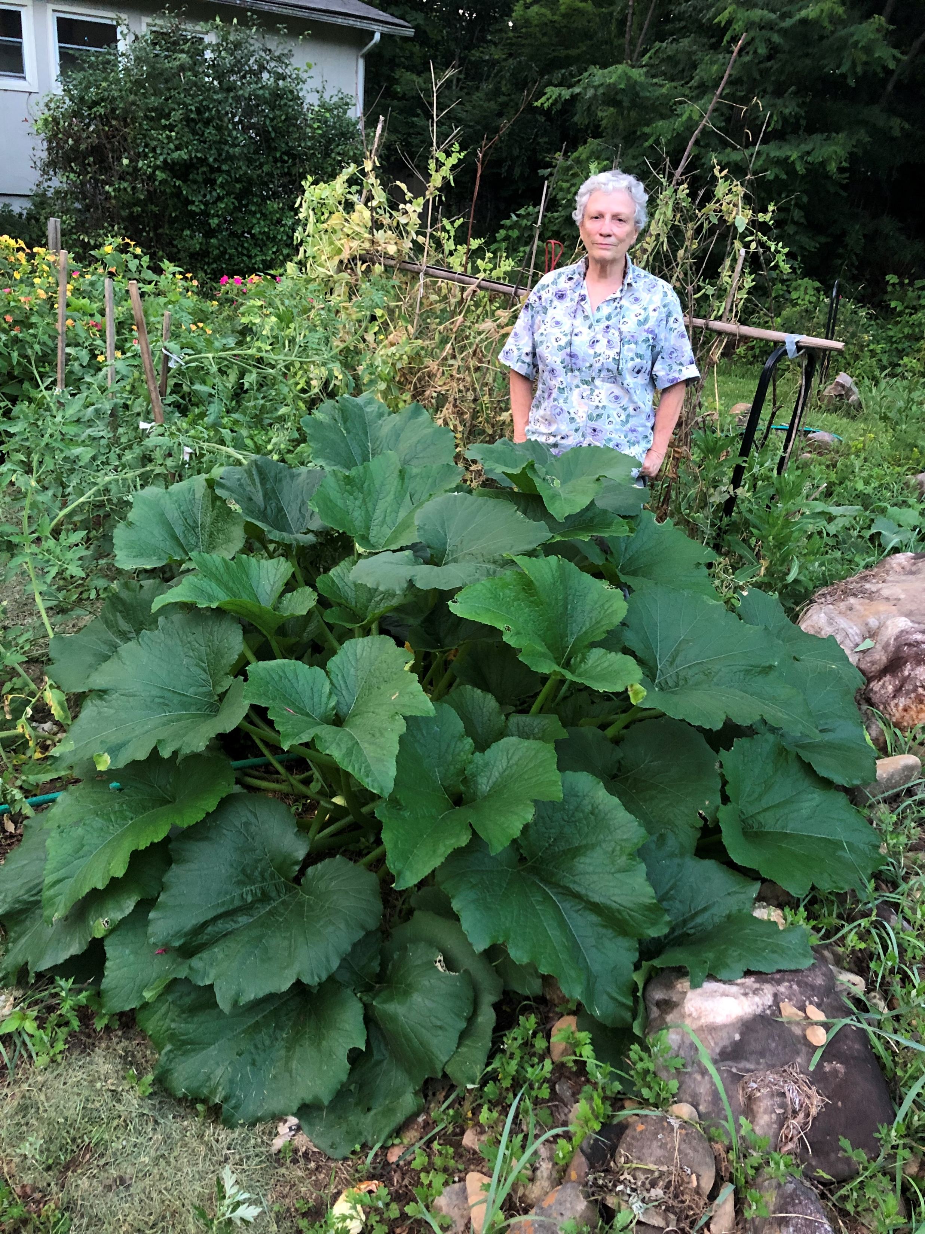

Slide 11
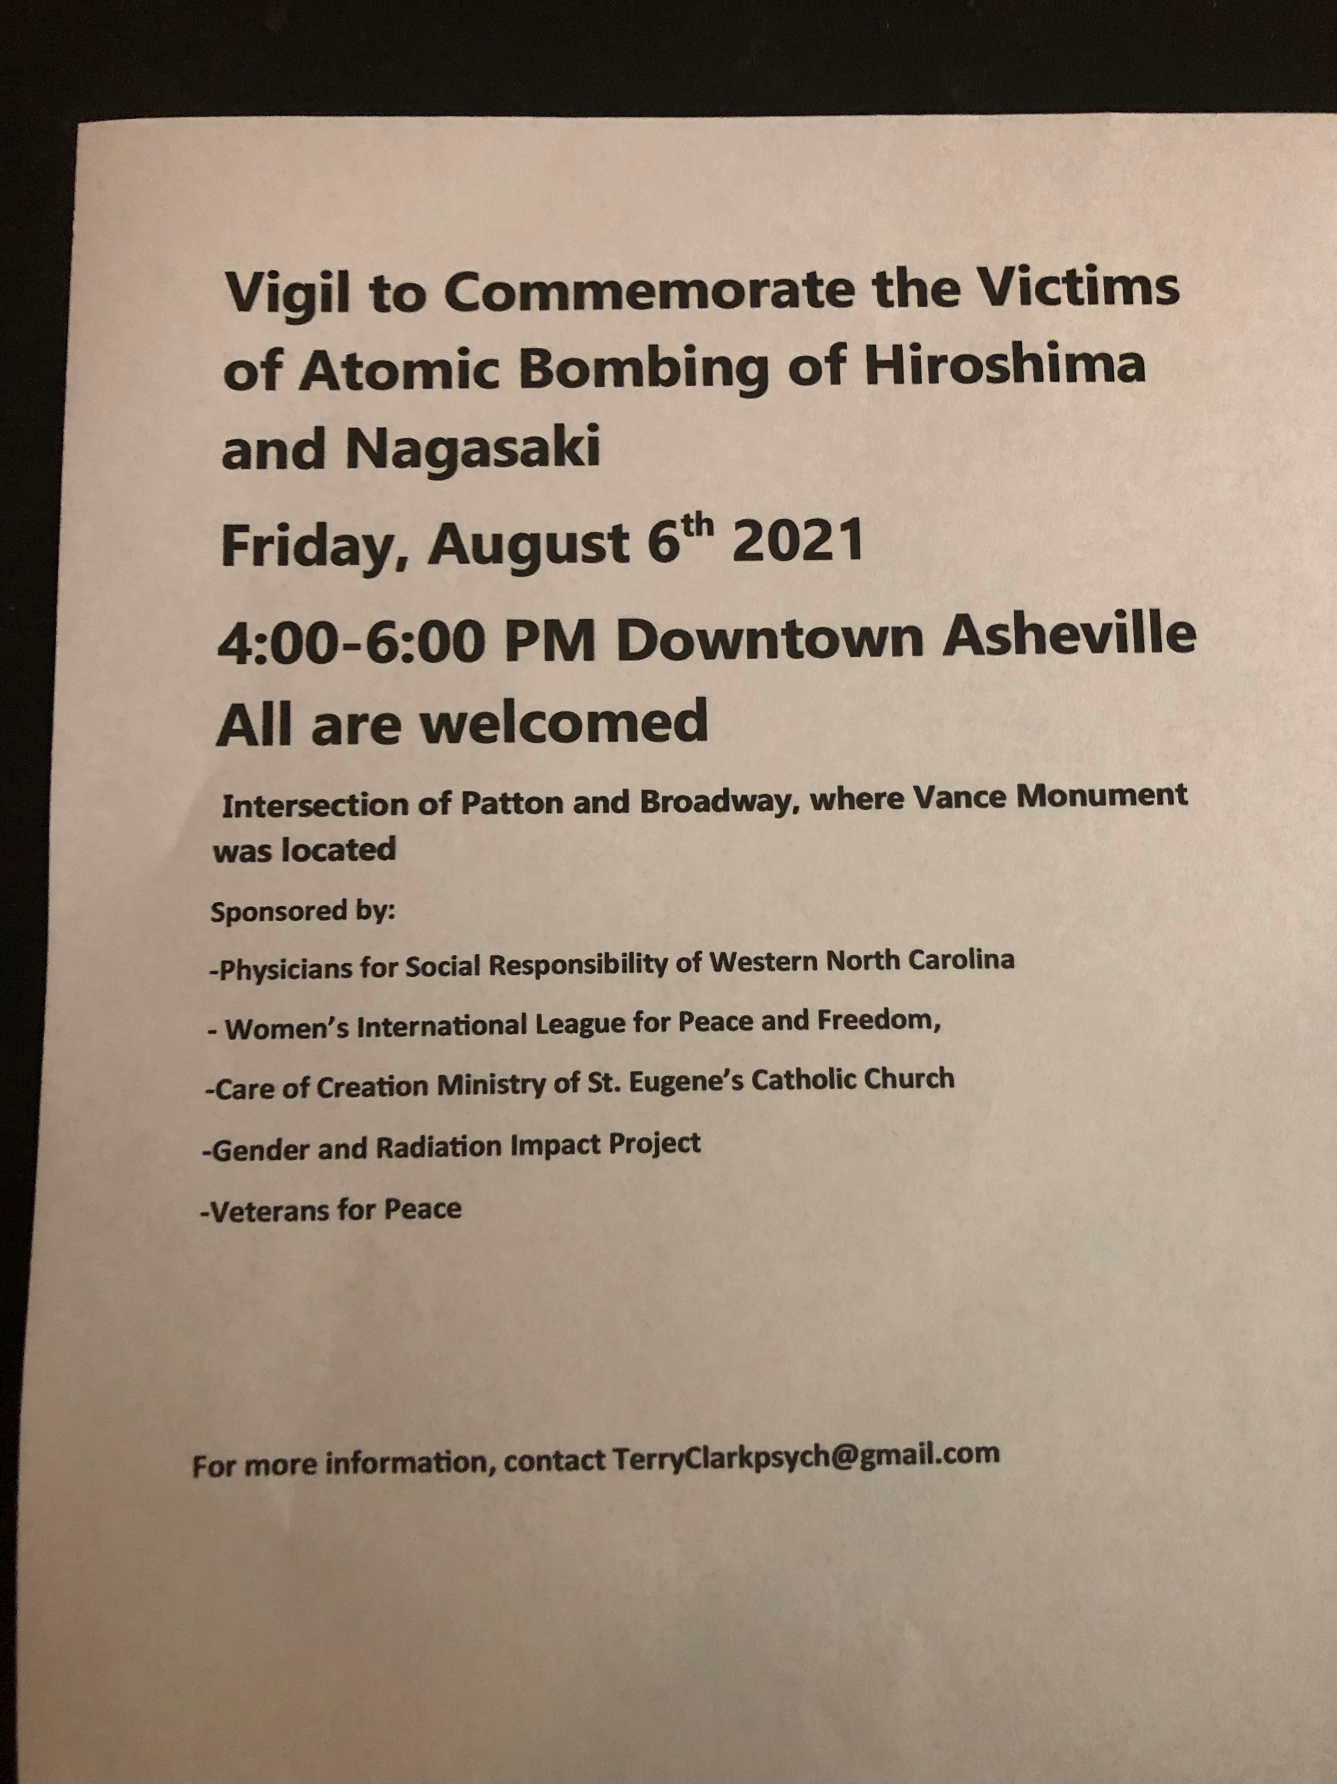

Slide 12
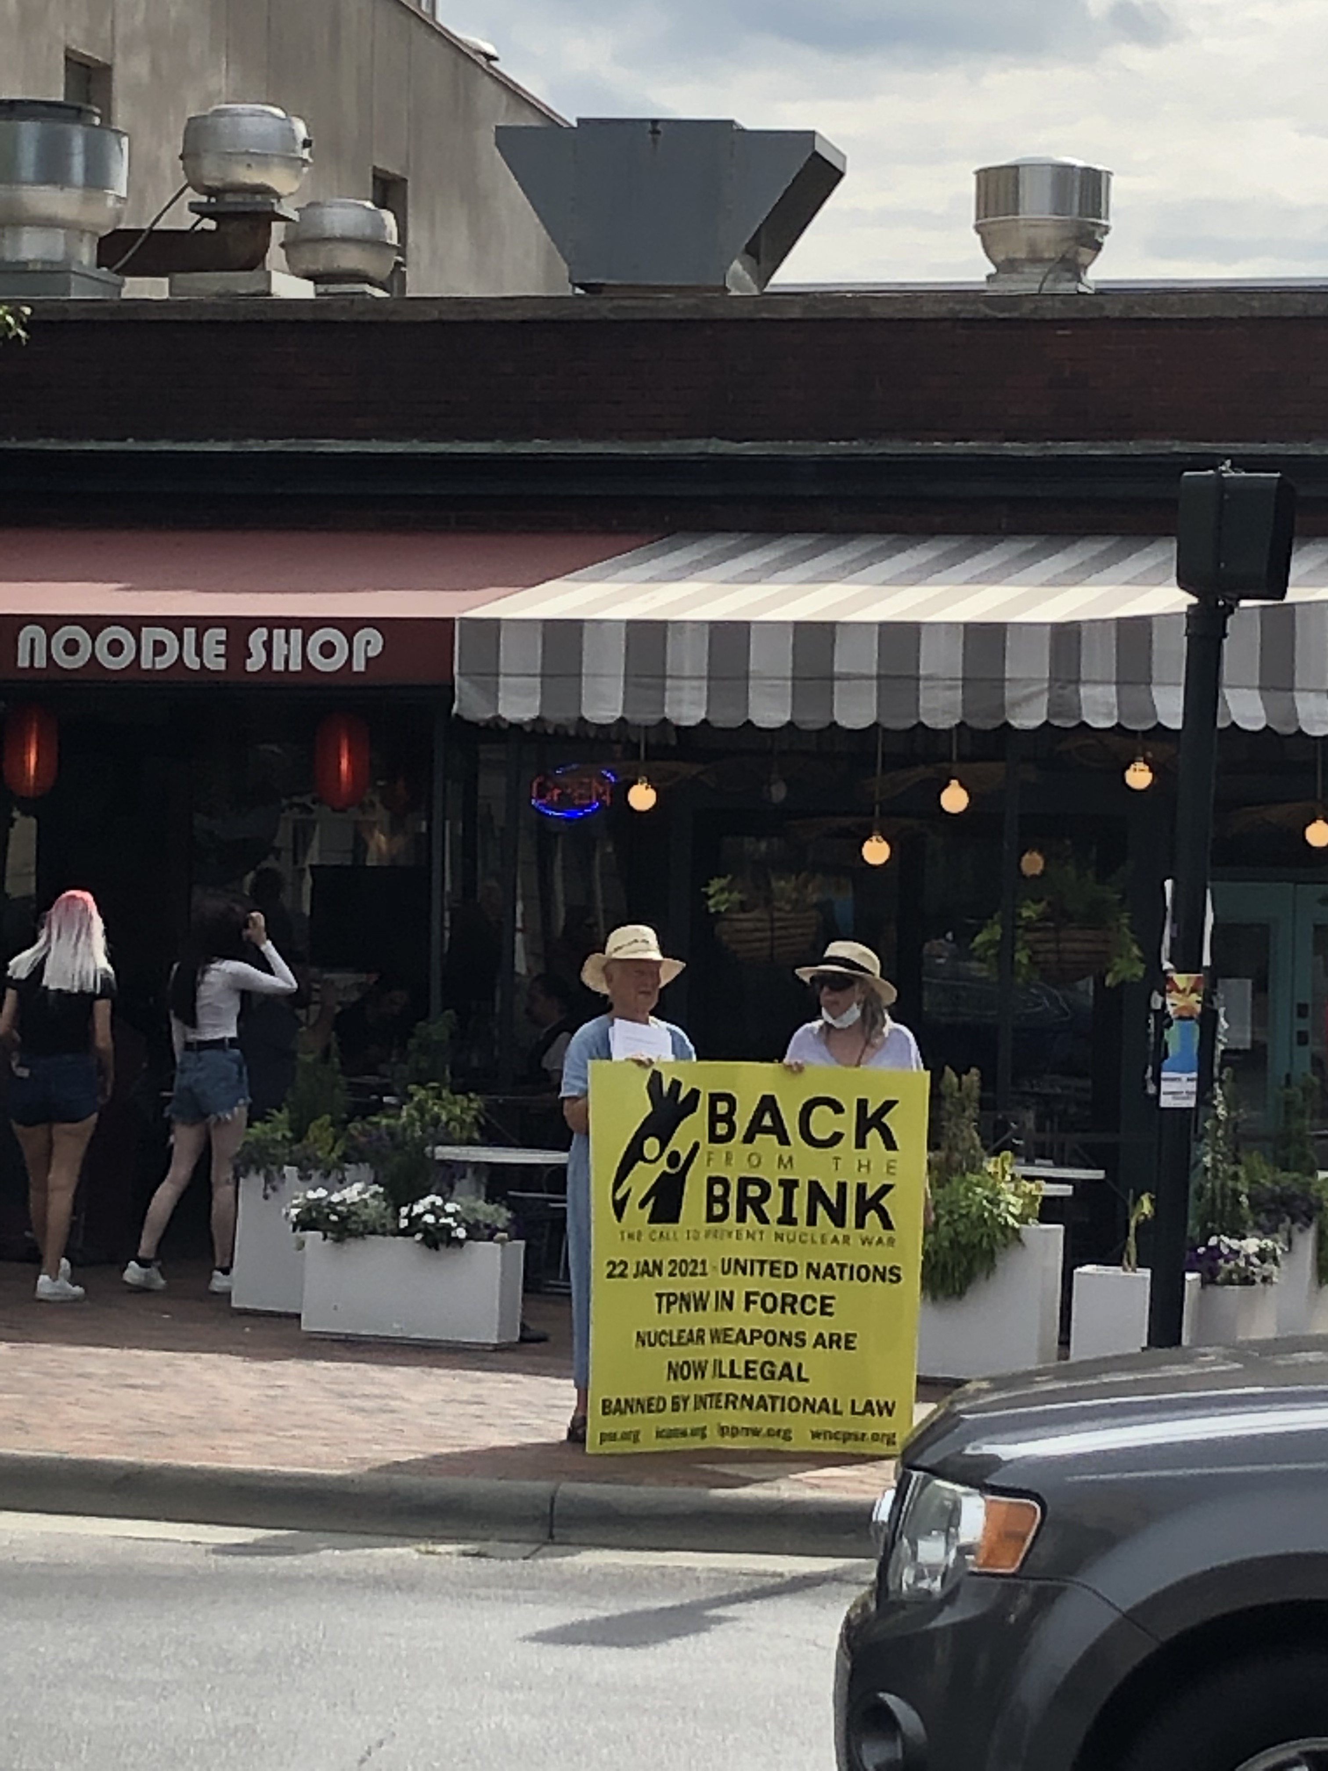

Slide 13
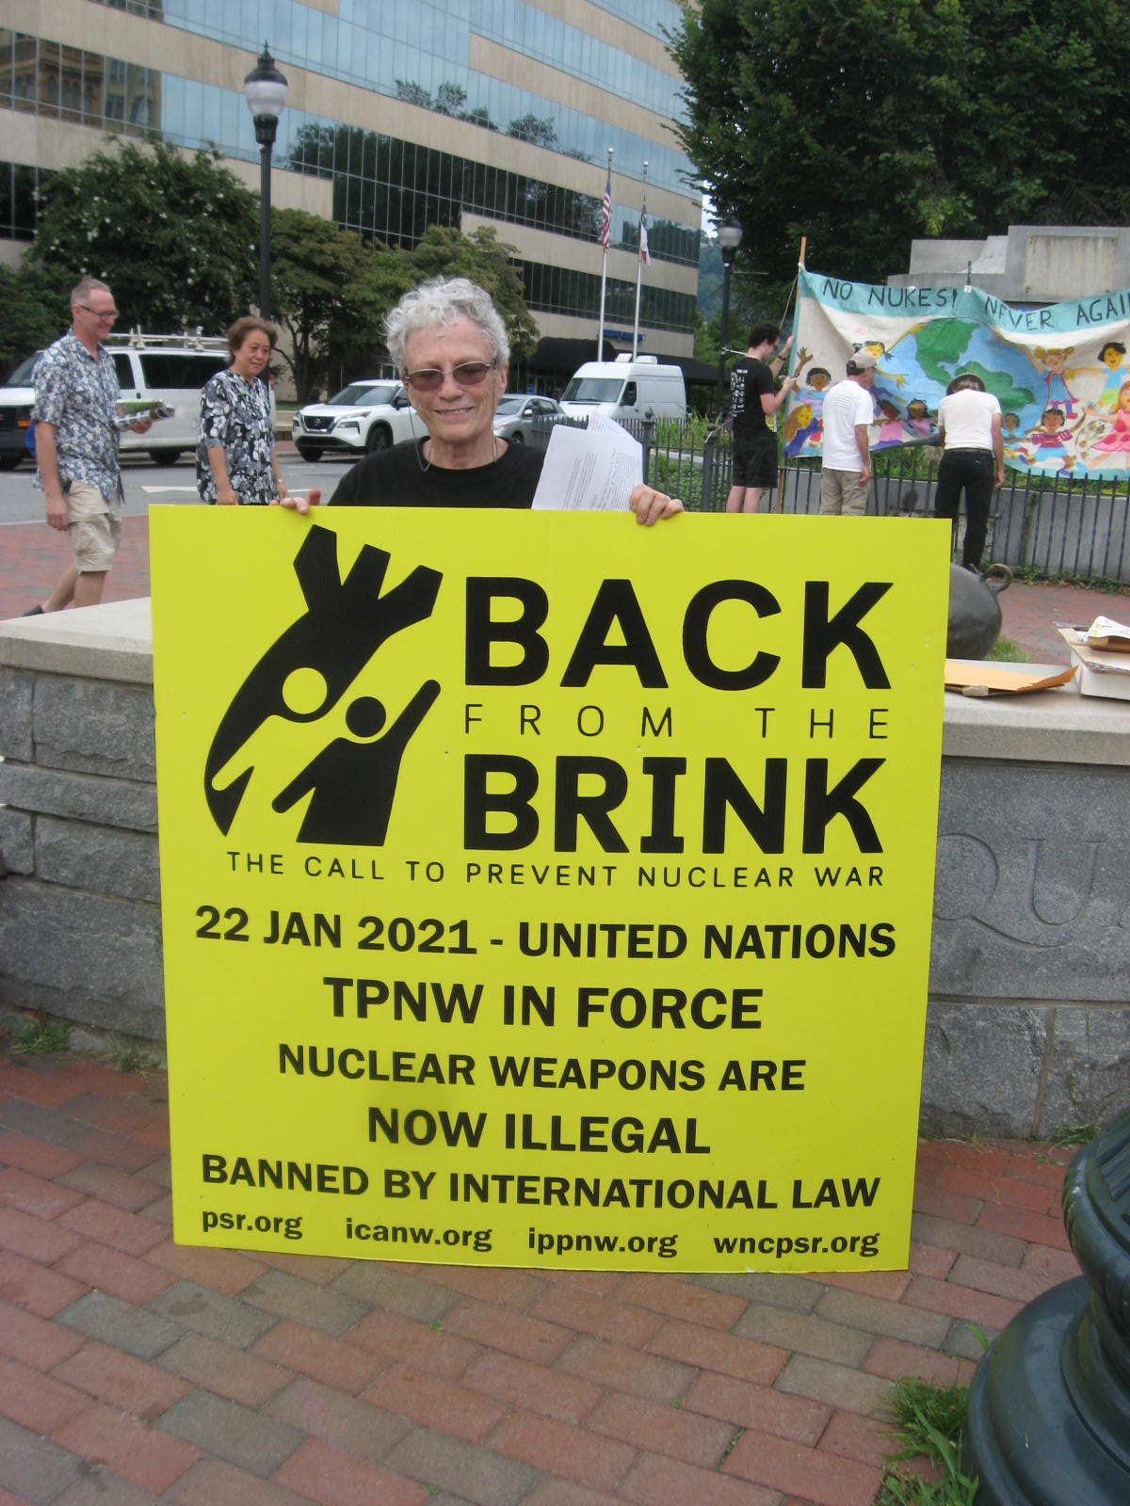

Slide 14
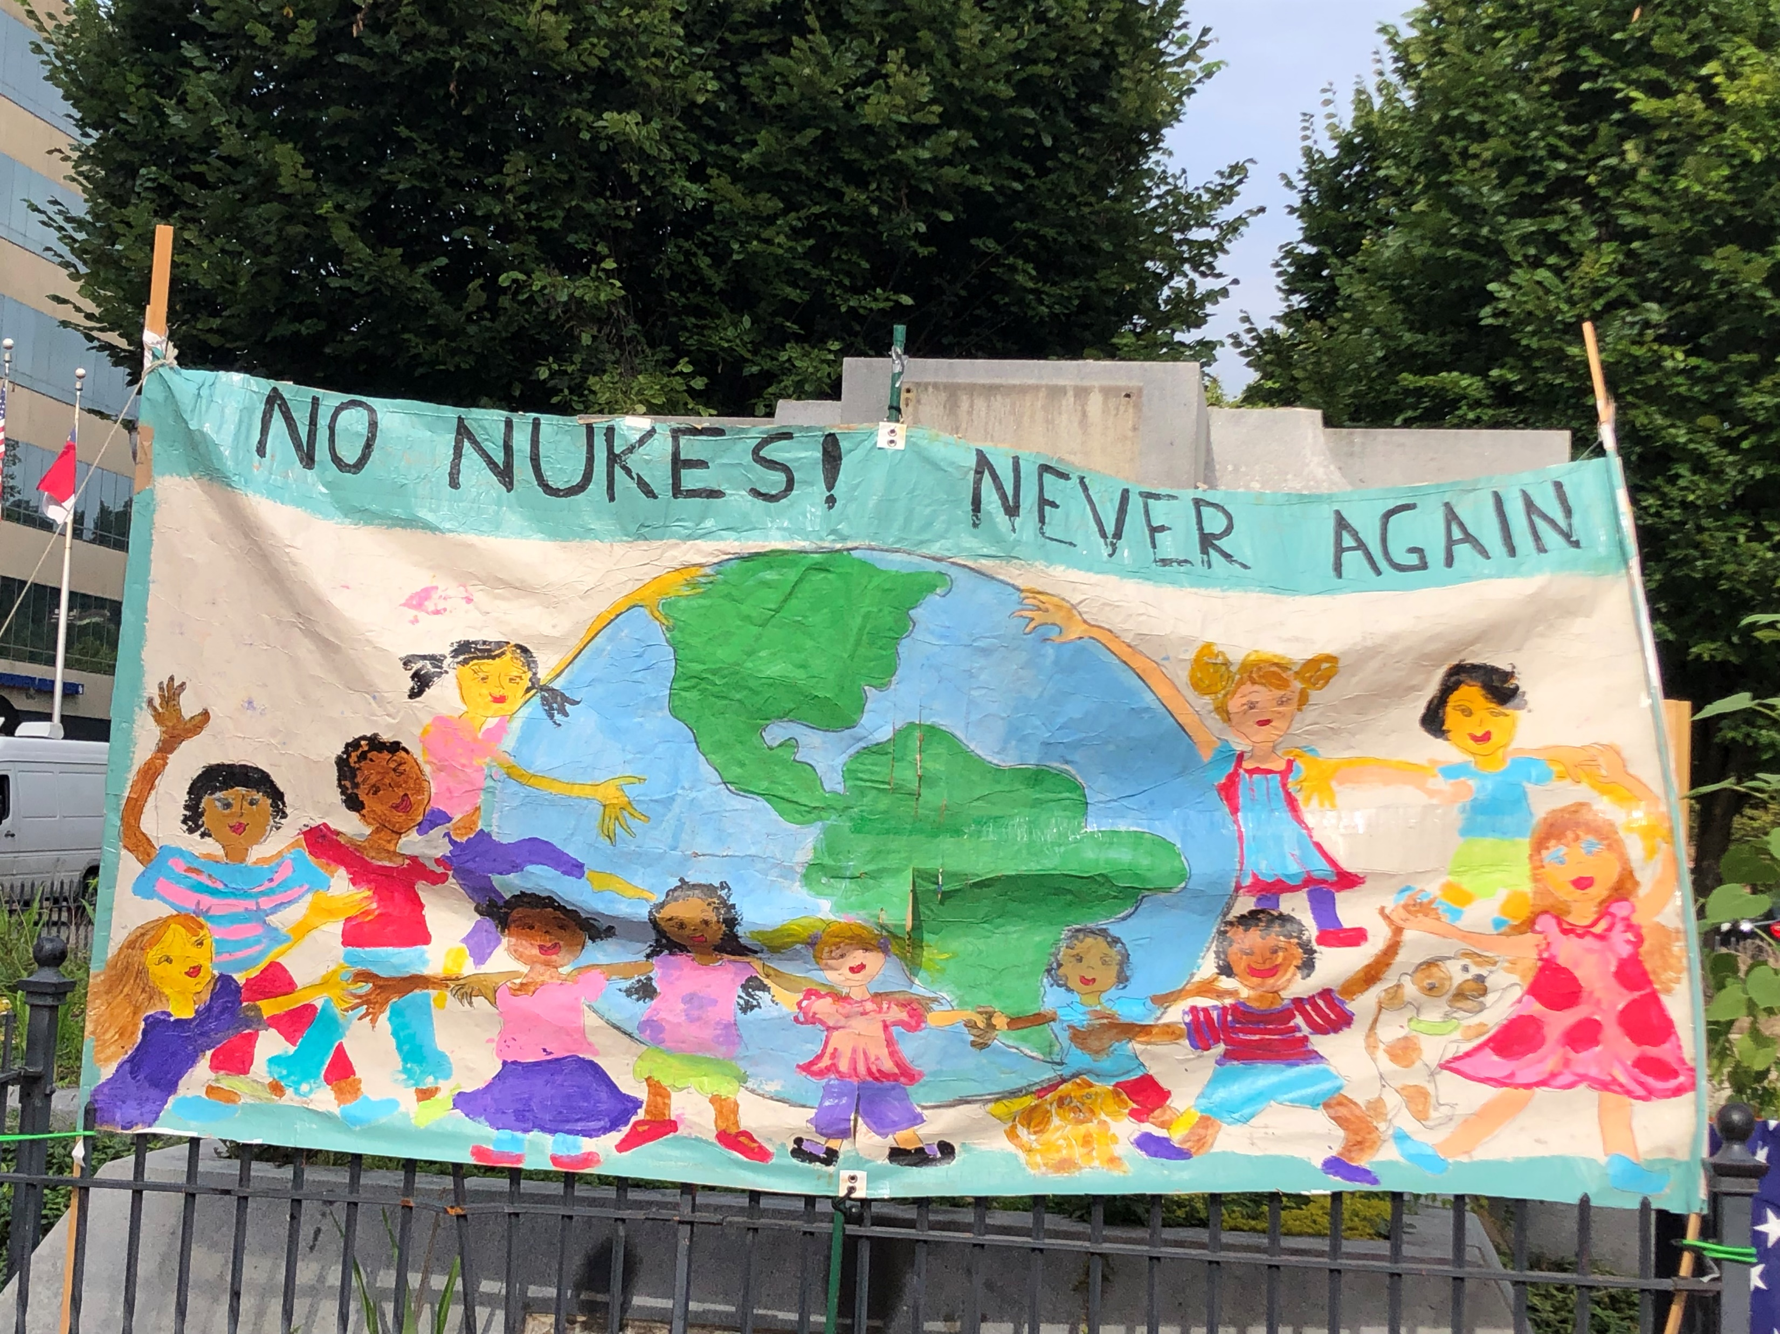

Slide 15
Our banner was designed and produced by our WNC PSR member Leslie Poplawski

Slide 16
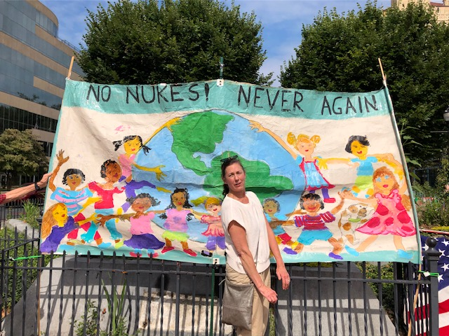

Slide 17
Lew Patrie and his daughter Lynn came out. Lew has been an active member of WNC PSR since the 1980’s.

Slide 18
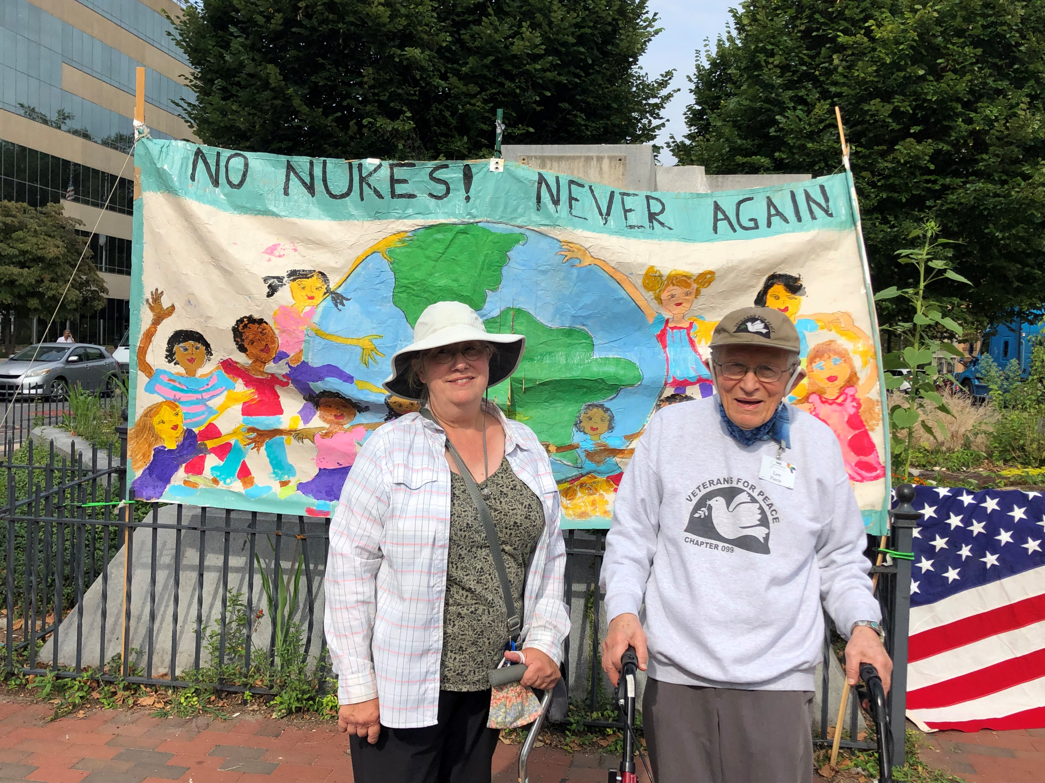

Slide 19
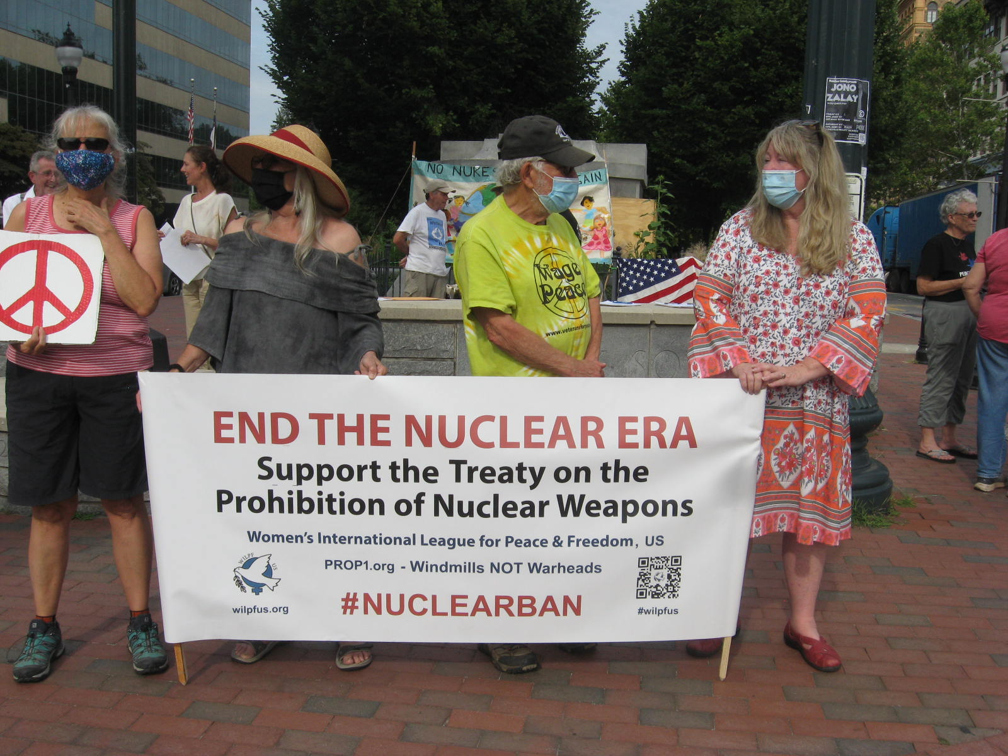

Slide 20
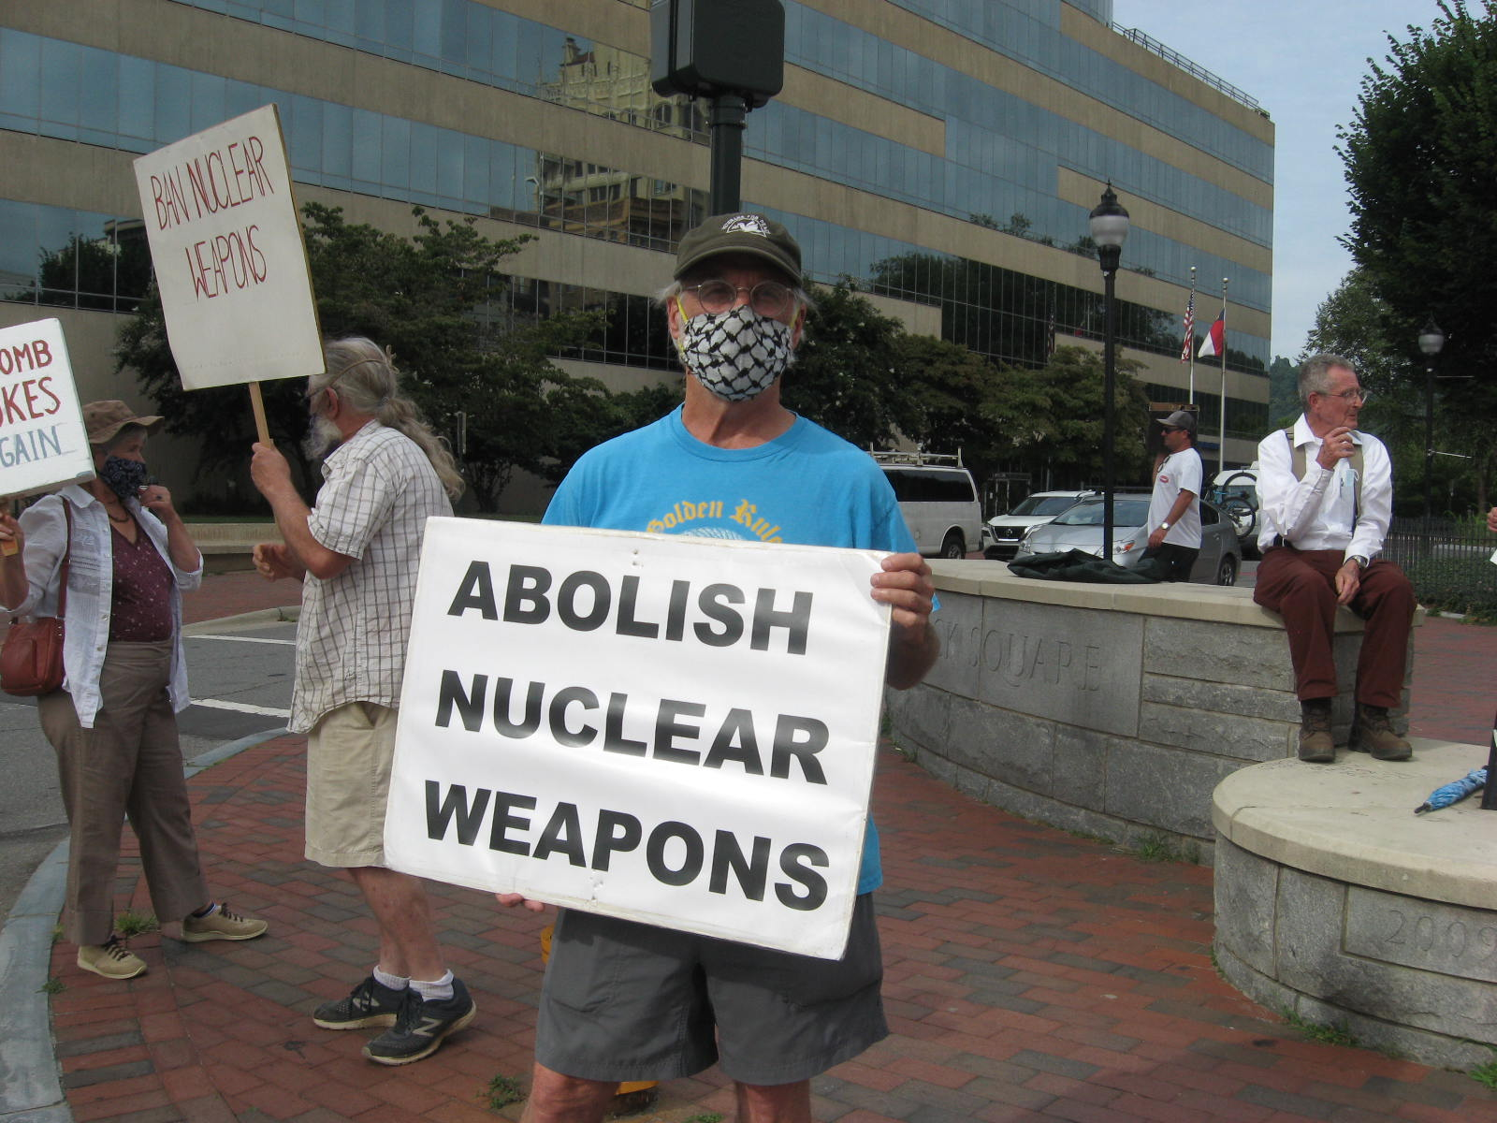

Slide 21
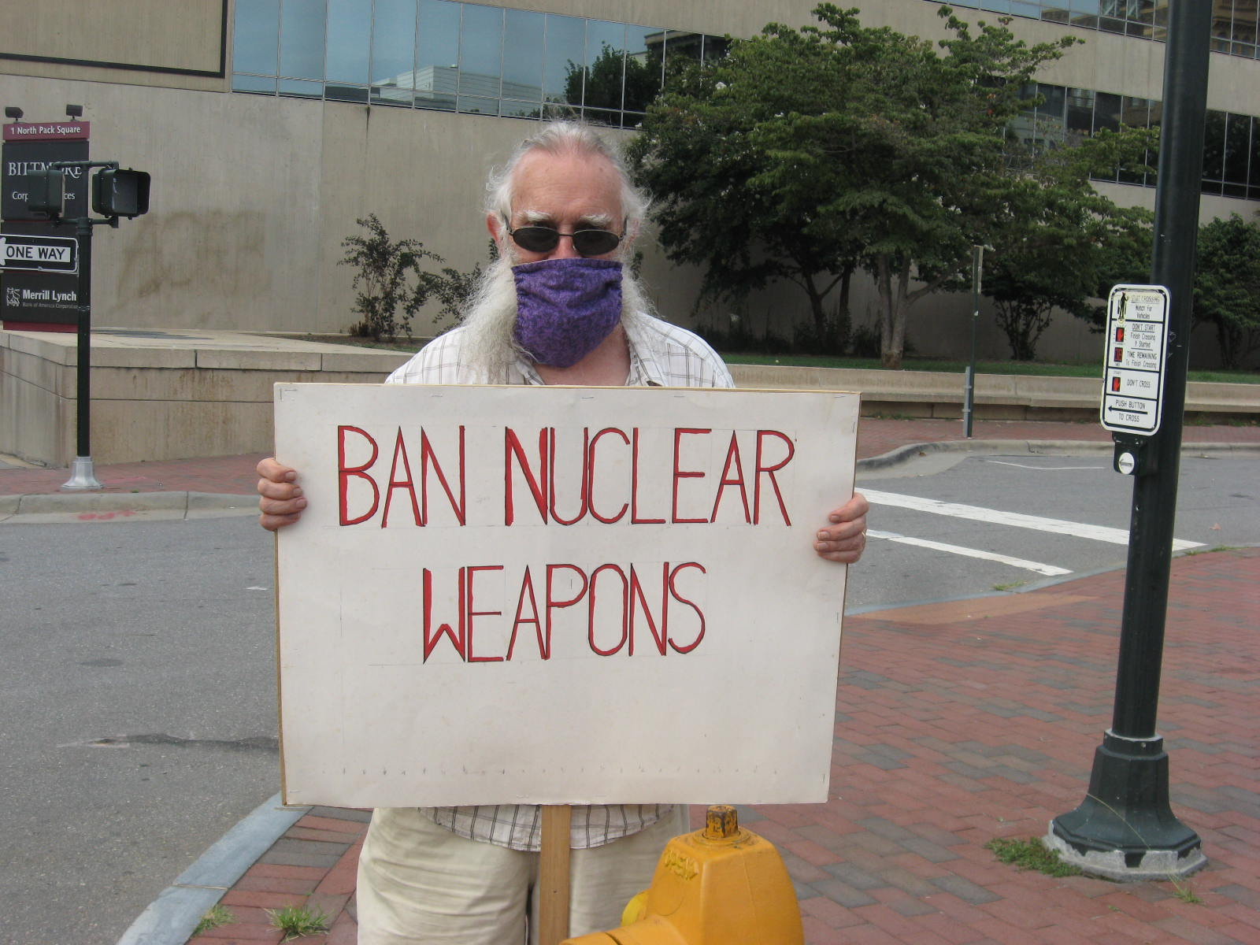

Slide 22
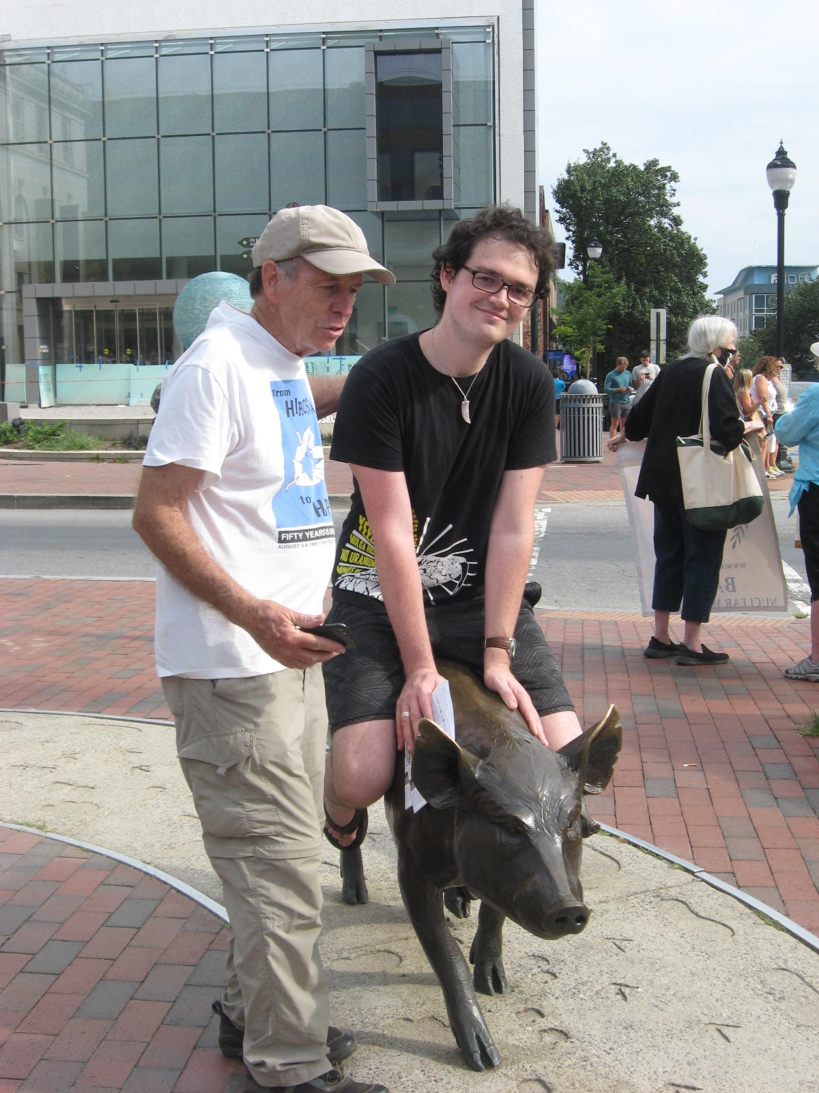

Slide 23
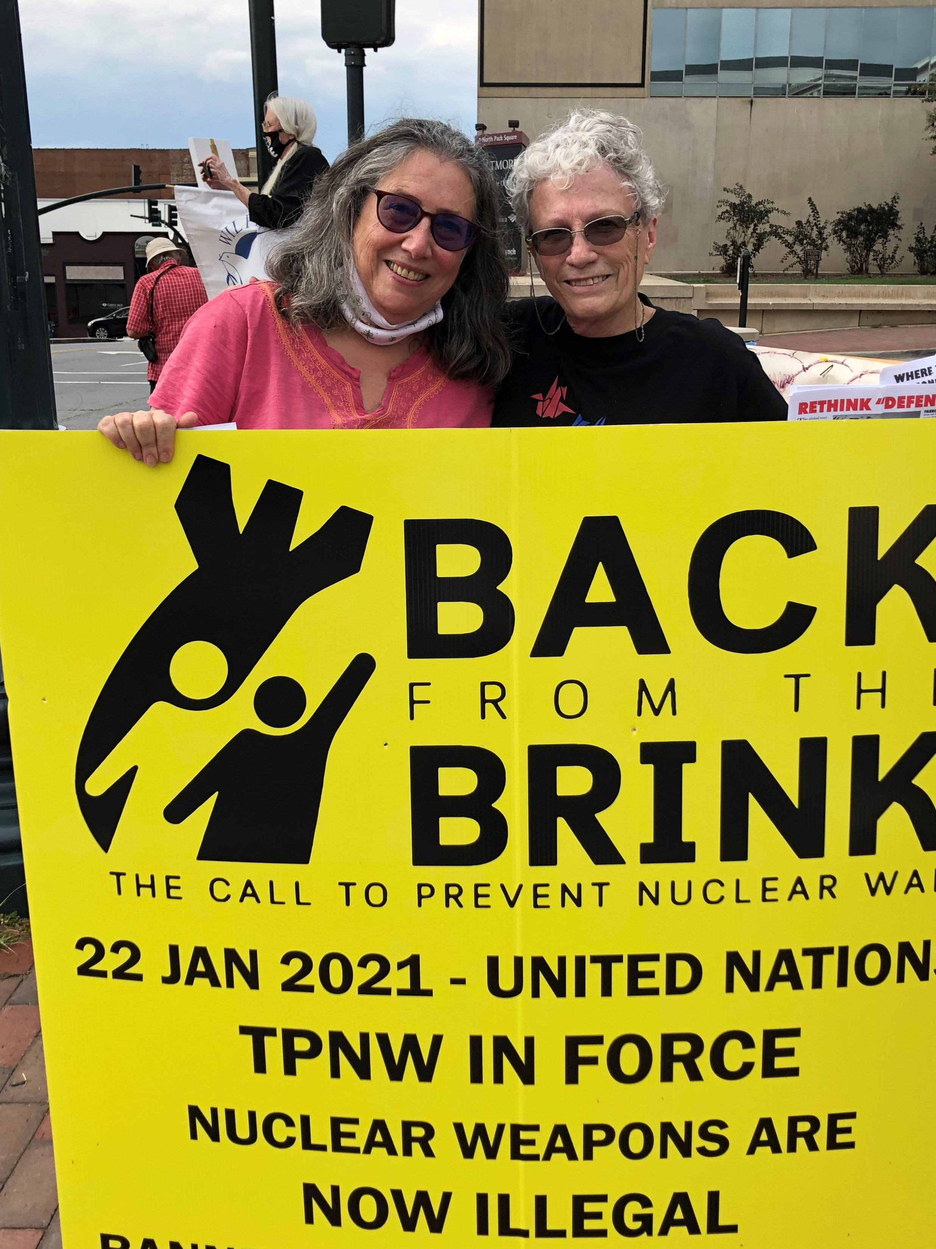

Slide 24
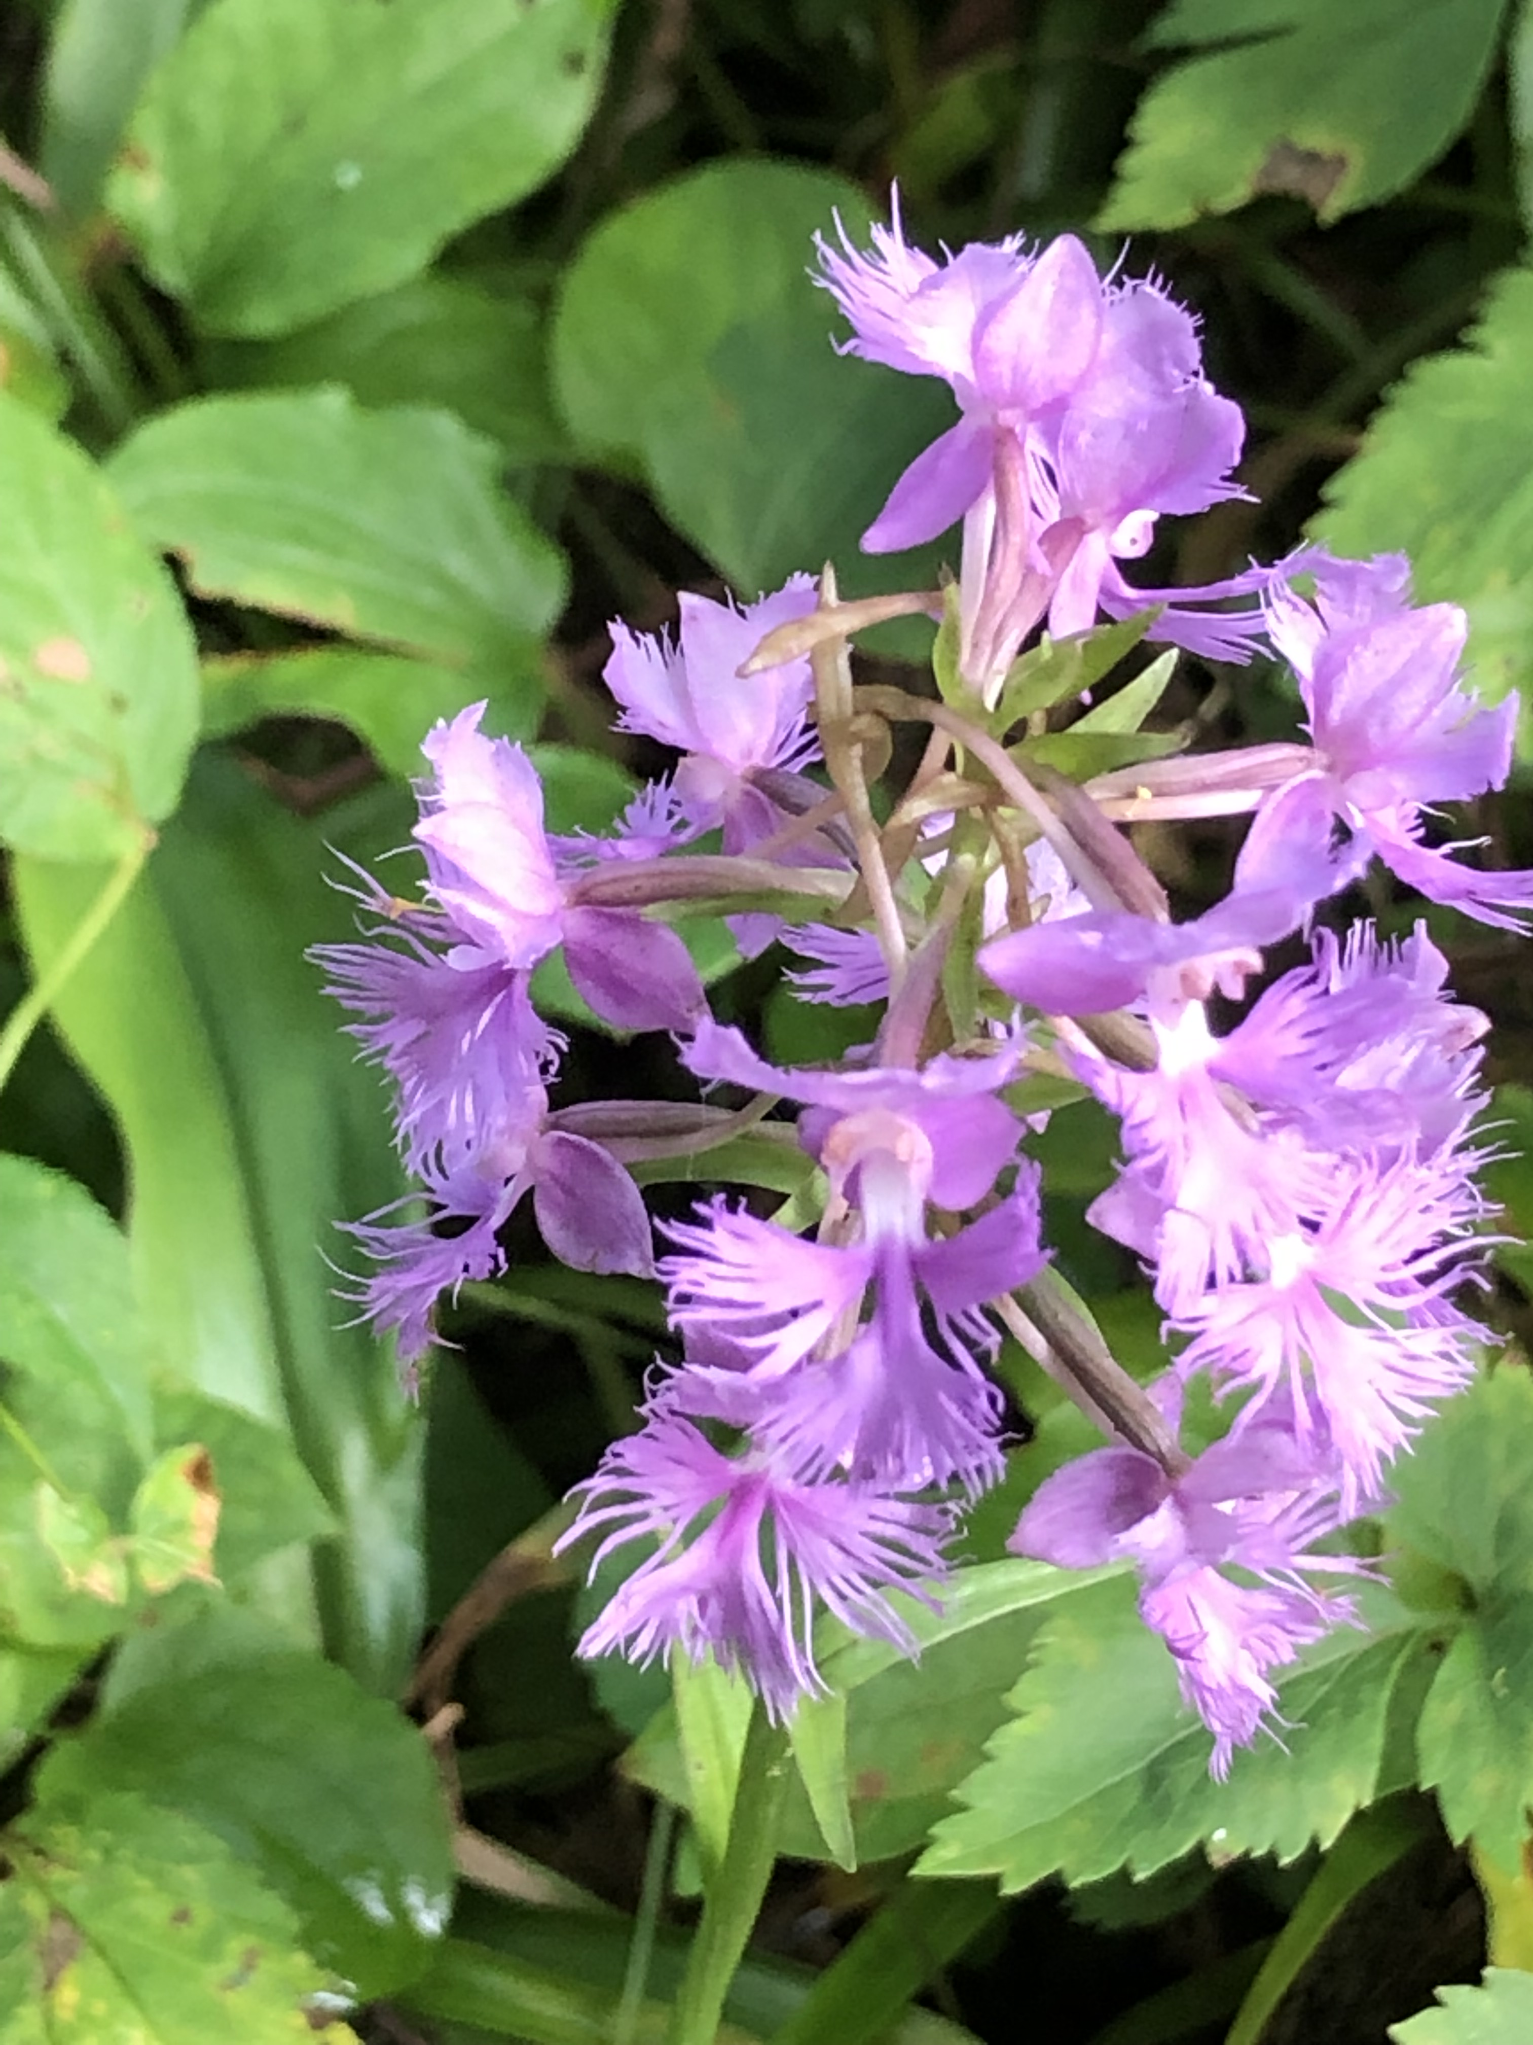

Slide 25
Physicians for Social Responsibility of Western North Carolina invites your support for our national organization.
Please make a donation at: www.psr.org

